Slide 1
Healthy Meals
Meals crafted with you in mind
Group 10
Richa Goel, Divya Jayaprakash, Niha Khan,
Gautami Murugan, Robert Myatt, Abhilash Ramprasad
ALLPPT.com _ Free PowerPoint Templates, Diagrams and Charts

Slide 2
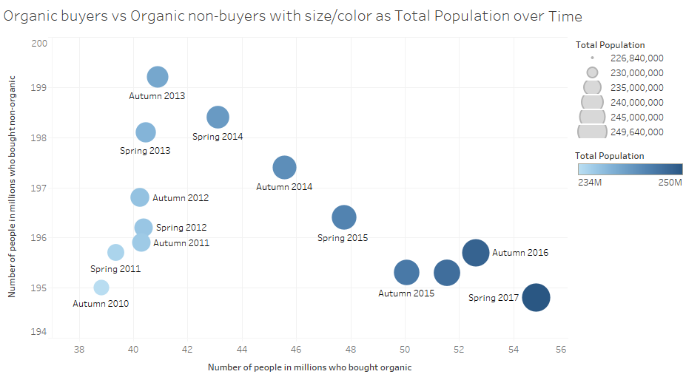
Slide 2: Organic Food Consumption
There has been an increase in the number of people who are buying Organic food since Autumn 2013
Notes:
Source(s):
Statista: https://www.statista.com/study/11646/us-organic-food-market-statista-dossier/

Slide 3
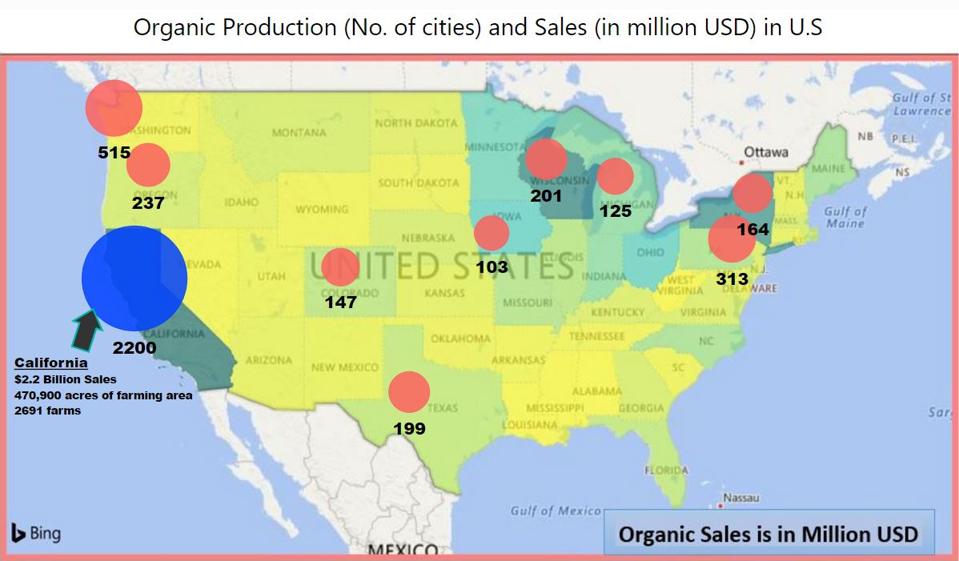
Slide 3: Organic Production and Sales
Highest production and sales of organic food in California
Our choice is to have two distribution centers in California
which will also serve as the food preparation site
Notes:
Source(s):
USDA Certified Growers: https://organic.ams.usda.gov/integrity/
USDA Census of Agriculture: https://www.agcensus.usda.gov/Newsroom/2015/09_17_2015.php

Slide 4
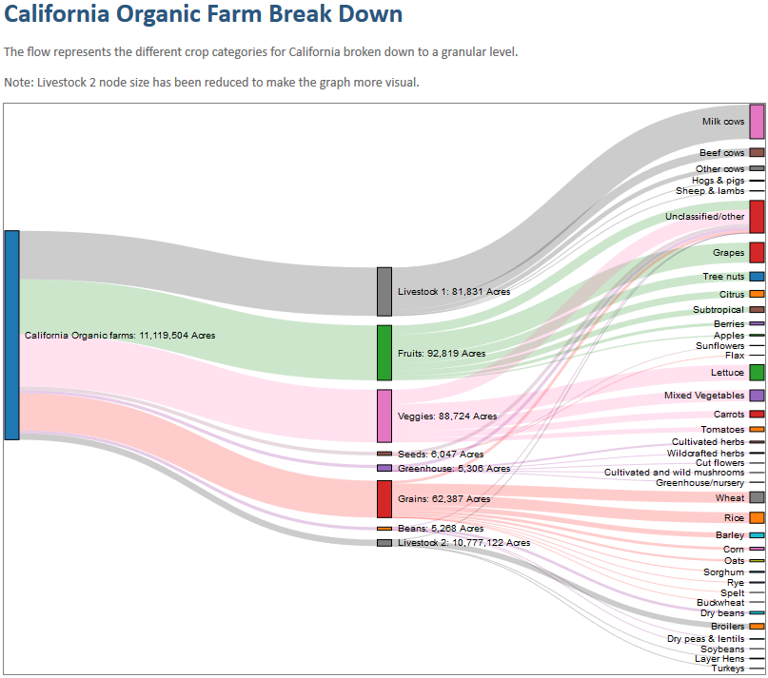
Slide 4: Types of Organic Food Produced
Breakdown of organic
farm production for
California in 2011 by
acre.
Livestock 2 has been
reduced by a factor of
1,000 in order to make
the graph more visible.
Notes:
Source(s):
United States Department of Agriculture: https://www.ers.usda.gov/data-products/organic-production.aspx

Slide 5
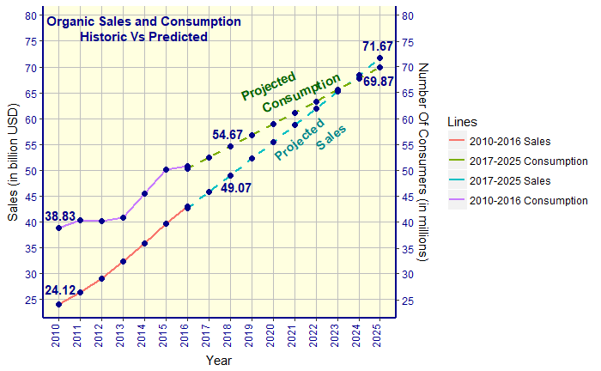
Slide 5: Predicted Growth
21 million new customers by 2025
24 billion USD increase in sales by 2025
Notes:
Source(s):
Statista: https://www.statista.com/study/11646/us-organic-food-market-statista-dossier/

Slide 6
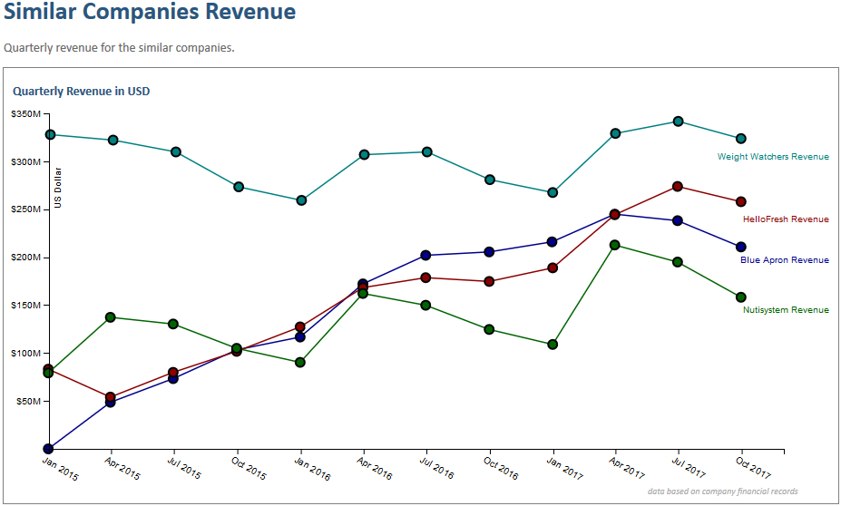
Slide 6: Financial Overview
Similar companies revenues have been stable or increasing over the last three years.
Notes:
Source(s):
Blue Apron: https://investors.blueapron.com/press-releases/2017
HelloFresh: https://www.hellofreshgroup.com/i-r/
Nutrisystem: https://amigobulls.com/stocks/NTRI/income-statement/quarterly
Weight Watchers: https://amigobulls.com/stocks/WTW/income-statement/quarterly

Slide 7
Slide 7: Summary
Food expenditures away from home has increased from 446,356 Million USD
(2003) to 731,258 Million USD (2014)
In 2013, the CDC reported a 50% increase in child food allergies from 1997 to
2011(1). Nine million adults in the US suffer from food allergies.
Why Healthy Meals:
Nutritionist (premium service - $9.99/month subscription)
Keep track of every customer's consumption and health condition
Specially customized food based on health condition and taste preferences
Send weekly nutrient consumption report to premium customers
Customers may preorder food for the week - prevents wasted food
Quality food priced as low as $8.99 per meal
With a positive trend in production, sales, consumption of organic
food, increased health consciousness, and the unique features of
our business, Healthy Meals is destined to be profitable.
Notes:
Source(s):
1. Food Allergies https://www.foodallergy.org/sites/default/files/migrated-files/file/facts-stats.pdf
With the increased production, sales, consumption of organic foods and the unique features of our business, Healthy Meals will be a sure shot success!
CDC – Centre for Disease Control

